Slide 1
Db2 for i inside of VS Code
Liam Allan
VSCode4i Architect
liama@ibm.com
Scott Forstie
Db2 for i – Business Architect
forstie@us.ibm.com

Slide 2
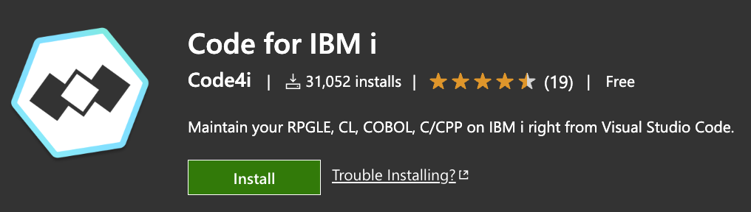
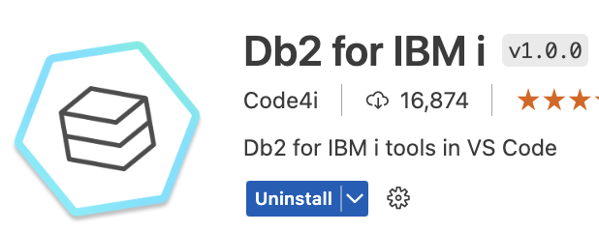
Db2 for IBM i Visual Studio Code Extension
Code for IBM i: Connect to IBM i and write RPG, CL, and more from VS Code
Db2 for IBM i: Connect to IBM i and write SQL
Run SQL statements
View database objects (schema browser)
Visual Explain
SQL Error Logging Facility
Notebooks
Start using the
Code4i Database Extension
https://marketplace.visualstudio.com/items?itemName=HalcyonTechLtd.vscode-db2i

Slide 3
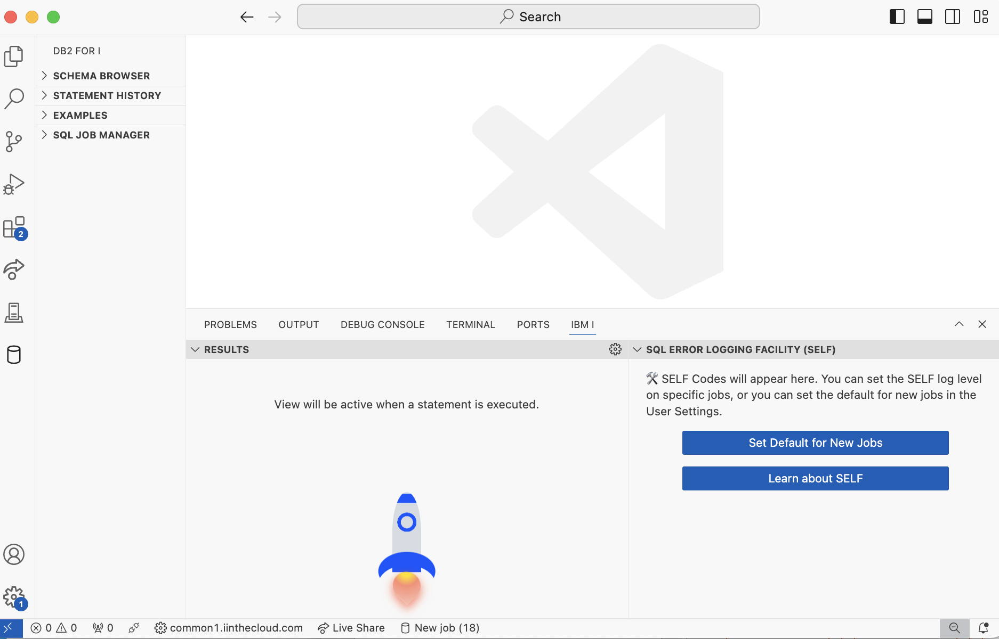
Meet the Database Extension

Slide 4

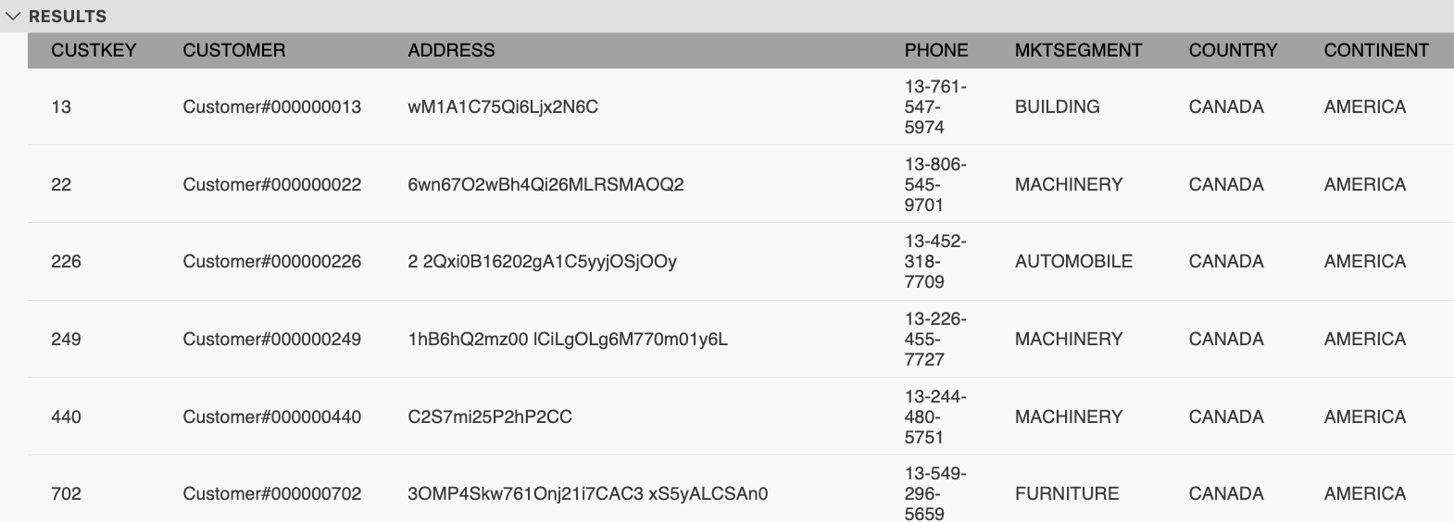
SQL Query and results

Slide 5
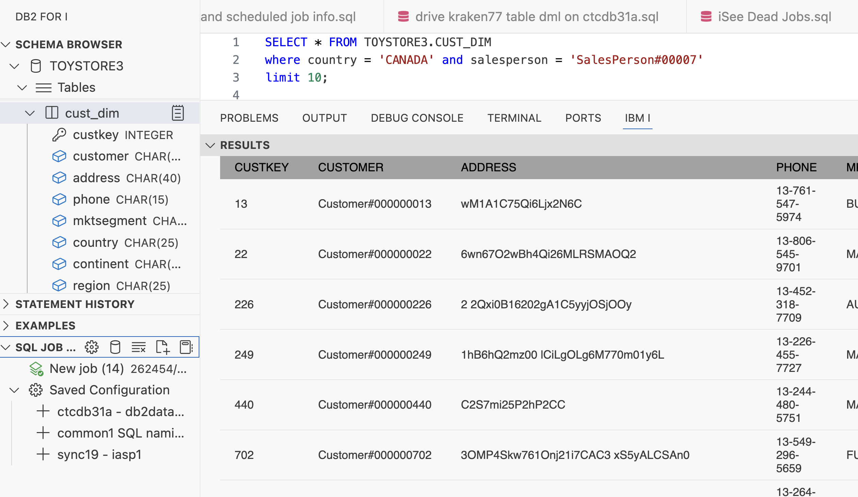
Data Load SQL Generator
Generate an INSERT with VALUES for this data

Slide 6
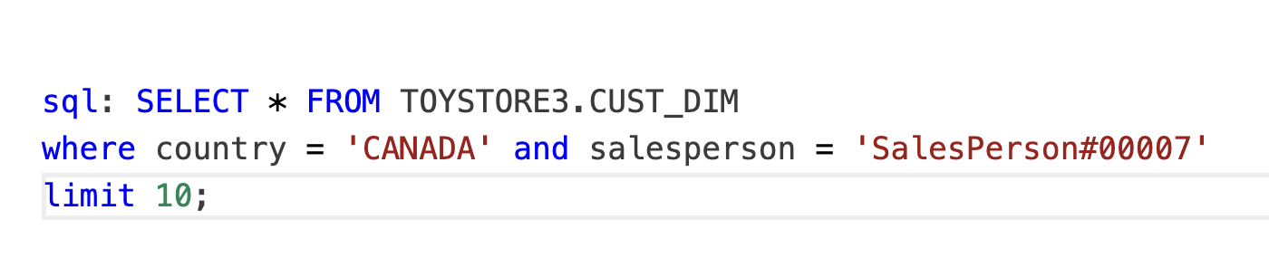
Data Load SQL Generator
Prefix the query with sql:

Slide 7
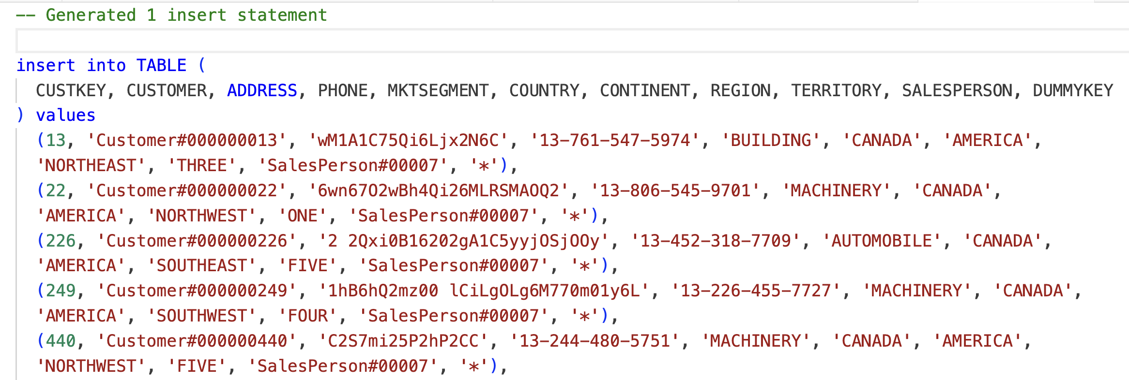
Data Load SQL Generator
Code4i built the INSERT with VALUES SQL statement

Slide 8
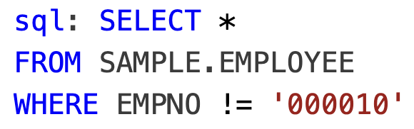
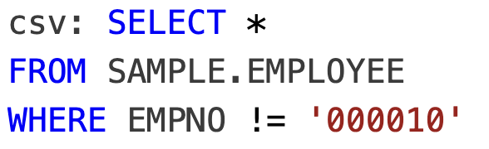
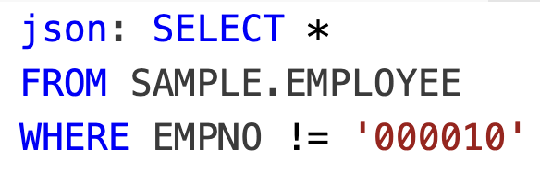
Data Load SQL Generators

Slide 9
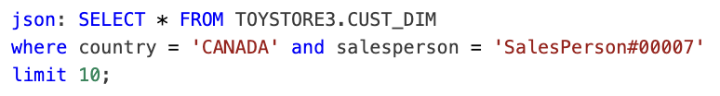
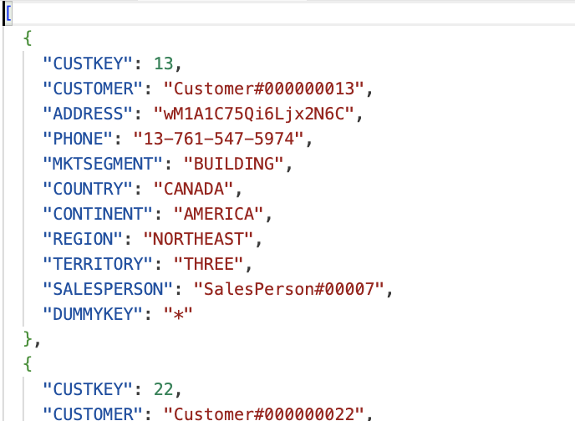
SQL Query and results published in JSON

Slide 10
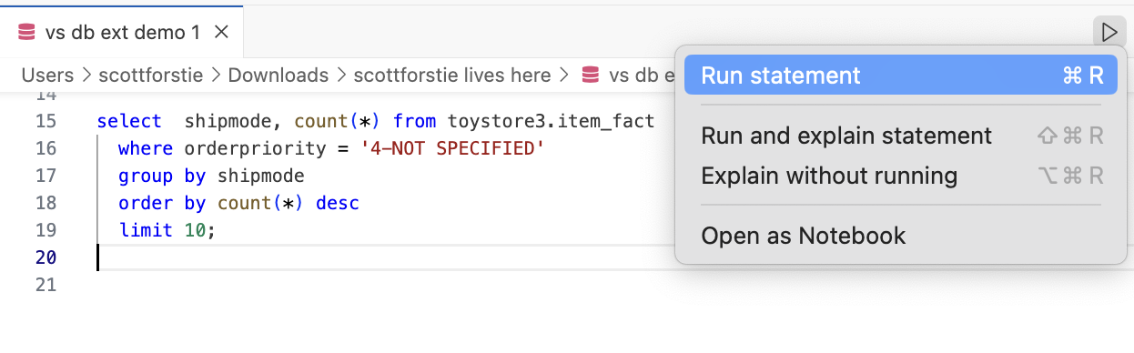
SQL Execution Options – Run
Execute the statement

Slide 11
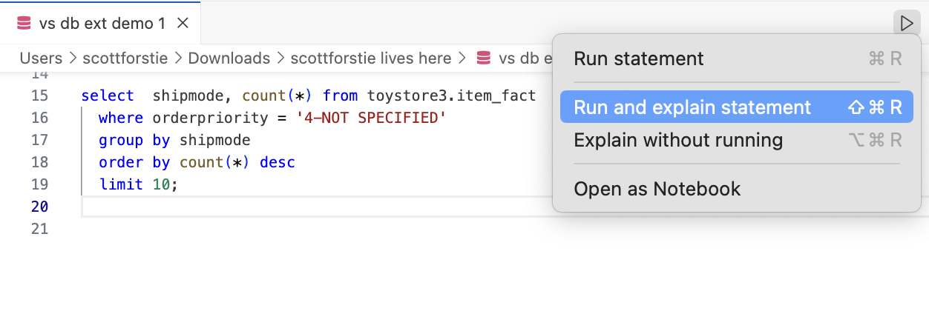
SQL Execution Options – Run and Explain
Execute and use Visual Explain to understand the query implementation

Slide 12
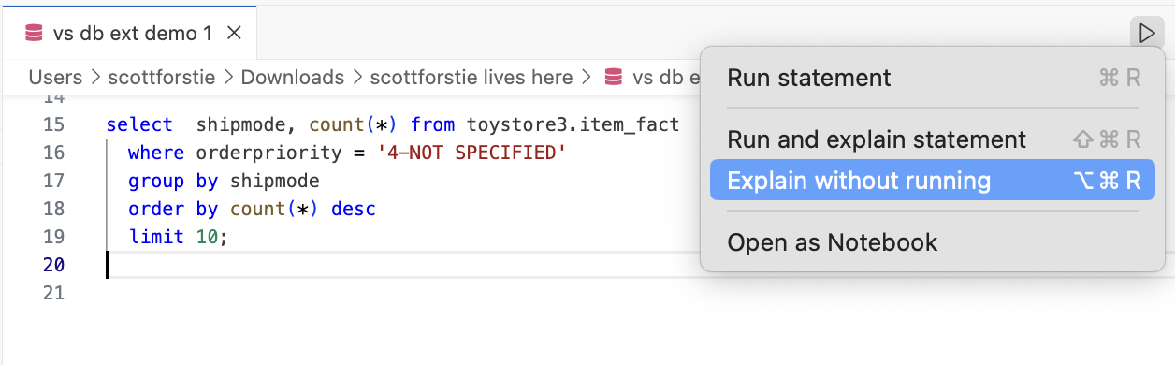
SQL Execution Options – Explain
Use Visual Explain to understand the possible query implementation

Slide 13
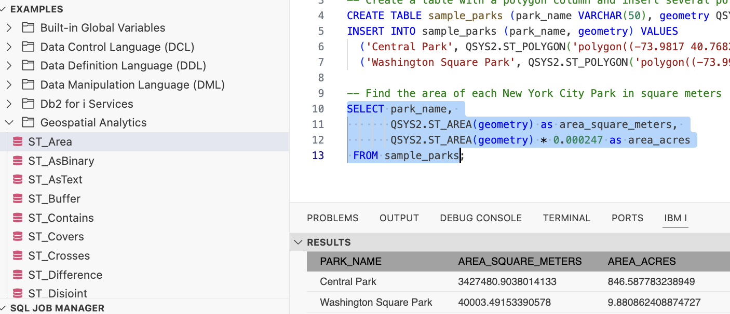
Insert from Examples

Slide 14
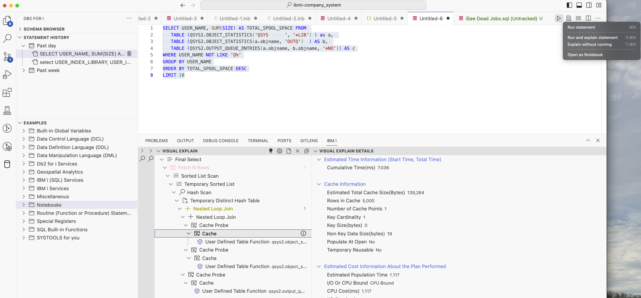
Db2 Extension within Code for i
Visual Explain Built-in!

Slide 15
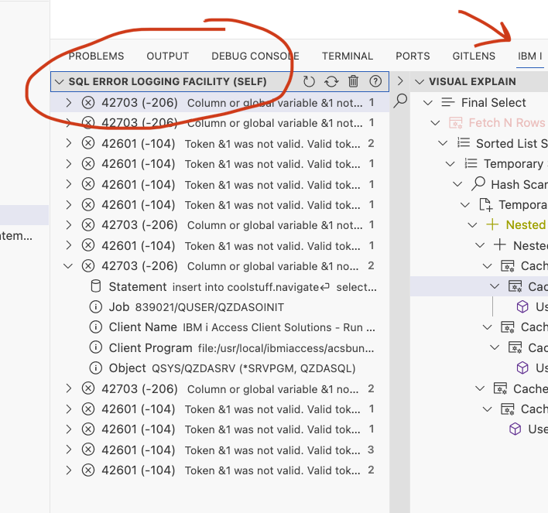
Support for the SQL Error Logging Facility (SELF)
Challenge: Finding, understanding, and fixing SQL errors and warnings
SELF - Captures details about user specified SQL errors or warnings
VsCode Db2 for i extension provides a new easy to use interface for seeing the item captured by SELF
https://www.ibm.com/support/pages/node/6828091

Slide 16
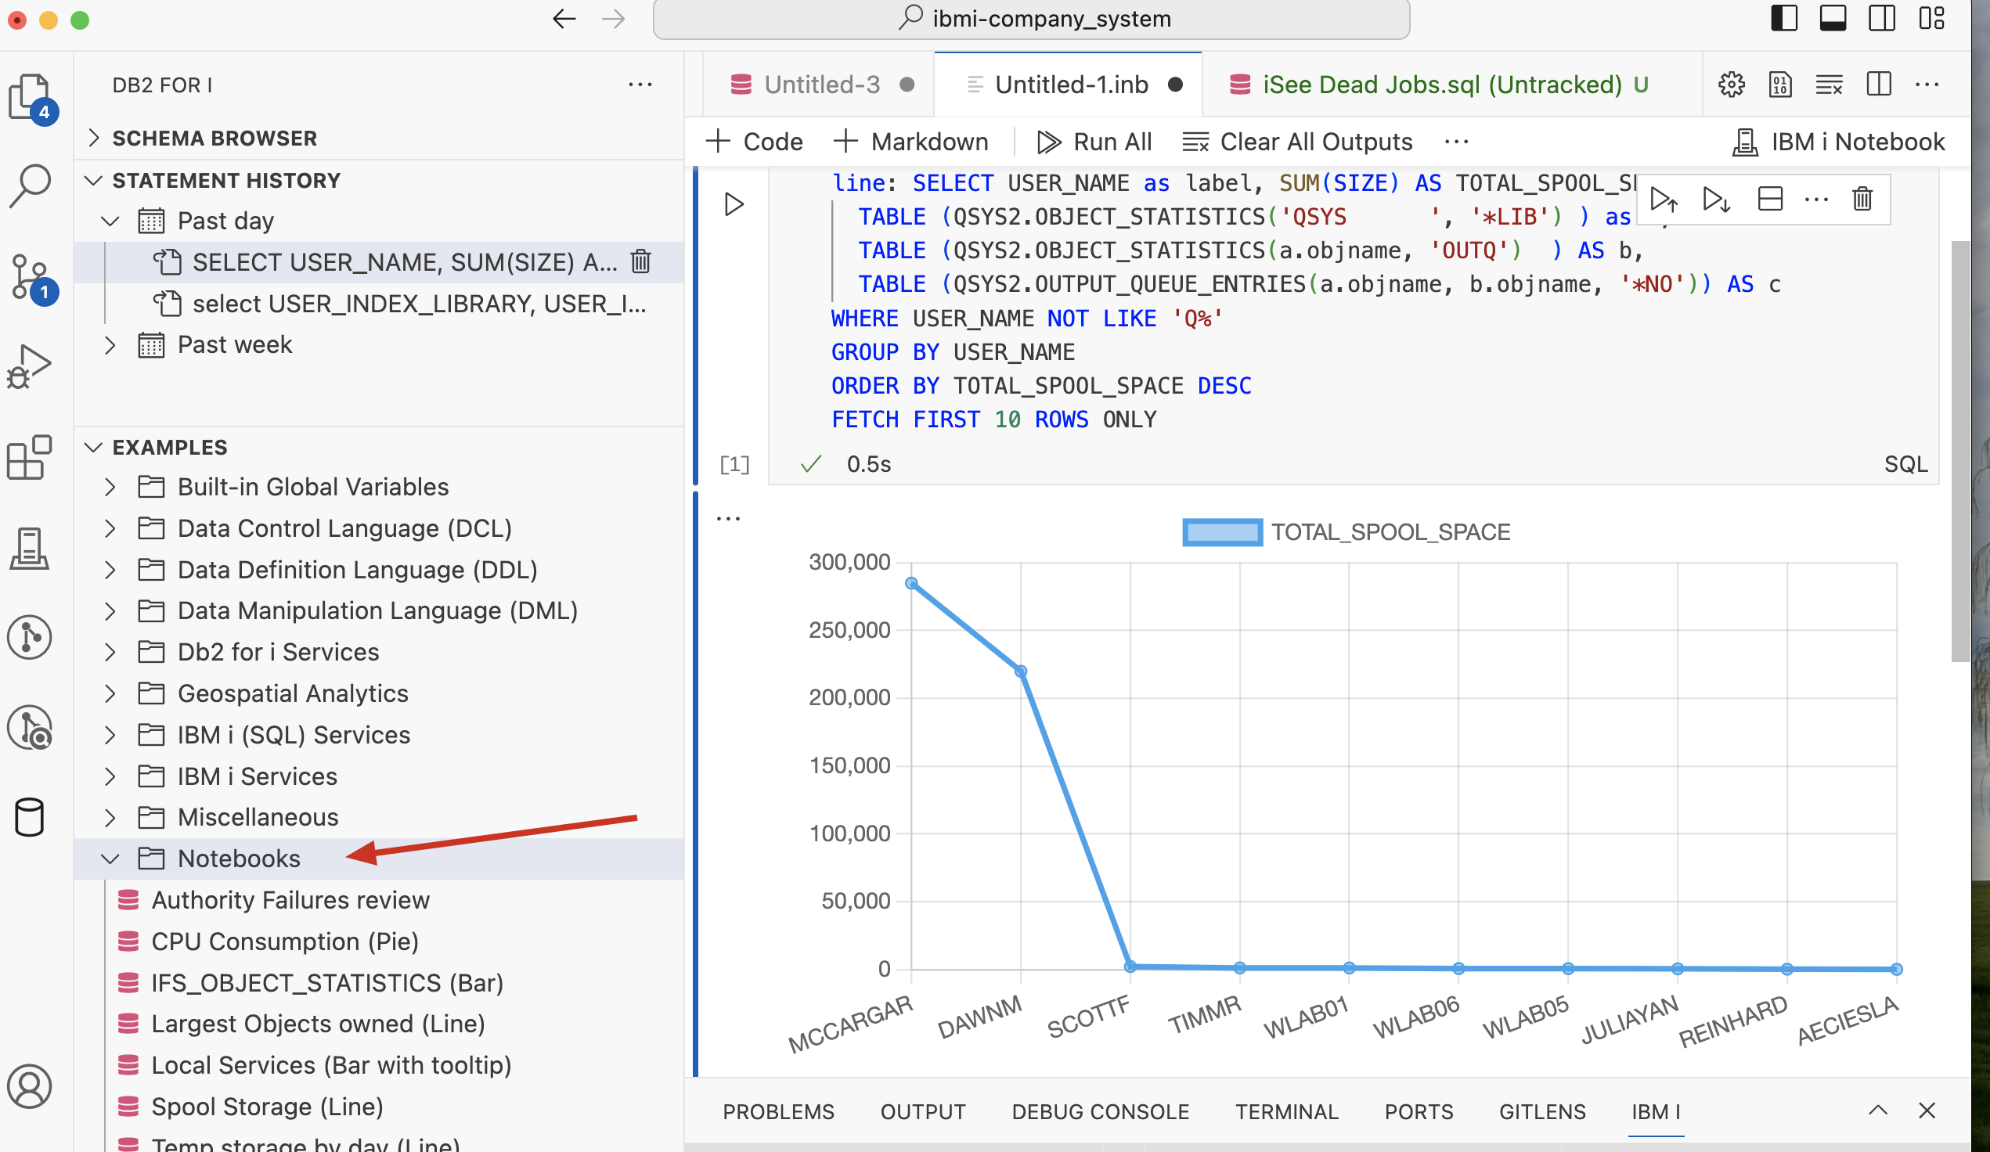
Notebooks
SQL
SQL Visualizations
in Graph form!
Graph

Slide 17

Demo Time

Slide 18
Thank You!
Db2 for i

Slide 19

For More Information:
Links You Need | Twitter | #Hashtags
IBM i Home Page: https://www.ibm.com/it-infrastructure/power/os/ibm-i (find link to Forrester Study and updated IBM i Strategy Whitepaper) IBM Strategy Whitepaper: https://www.ibm.com/it-infrastructure/us-en/resources/power/i-strategy-roadmap/ IBM Client Success: https://www.ibm.com/it-infrastructure/us-en/resources/power/ibm-i-customer-stories/ Support Life Cycle: https://www.ibm.com/support/lifecycle/ License Topics: https://www-01.ibm.com/support/docview.wss?uid=nas8N1022087 HelpSystems 2024 Marketplace Survey https://www.helpsystems.com/resources/guides/ibm-i-marketplace-survey-results | @IBMSystems @COMMONug @IBMChampions @IBMSystemsISVs @IBMiMag @ITJungleNews @SAPonIBMi @SiDforIBMi | #PowerSystems #IBMi #IBMAIX #POWER10 #LinuxonPower #OpenPOWER #HANAonPower #ITinfrastructure #OpenSource #HybridCloud #BigData

Slide 20
Special notices
This document was developed for IBM offerings in the United States as of the date of publication. IBM may not make these offerings available in other countries, and the information is subject to change without notice. Consult your local IBM business contact for information on the IBM offerings available in your area.
Information in this document concerning non-IBM products was obtained from the suppliers of these products or other public sources. Questions on the capabilities of non-IBM products should be addressed to the suppliers of those products.
IBM may have patents or pending patent applications covering subject matter in this document. The furnishing of this document does not give you any license to these patents. Send license inquires, in writing, to IBM Director of Licensing, IBM Corporation, New Castle Drive, Armonk, NY 10504-1785 USA.
All statements regarding IBM future direction and intent are subject to change or withdrawal without notice, and represent goals and objectives only.
The information contained in this document has not been submitted to any formal IBM test and is provided "AS IS" with no warranties or guarantees either expressed or implied.
All examples cited or described in this document are presented as illustrations of the manner in which some IBM products can be used and the results that may be achieved. Actual environmental costs and performance characteristics will vary depending on individual client configurations and conditions.
IBM Global Financing offerings are provided through IBM Credit Corporation in the United States and other IBM subsidiaries and divisions worldwide to qualified commercial and government clients. Rates are based on a client's credit rating, financing terms, offering type, equipment type and options, and may vary by country. Other restrictions may apply. Rates and offerings are subject to change, extension or withdrawal without notice.
IBM is not responsible for printing errors in this document that result in pricing or information inaccuracies.
All prices shown are IBM's United States suggested list prices and are subject to change without notice; reseller prices may vary.
IBM hardware products are manufactured from new parts, or new and serviceable used parts. Regardless, our warranty terms apply.
Any performance data contained in this document was determined in a controlled environment. Actual results may vary significantly and are dependent on many factors including system hardware configuration and software design and configuration. Some measurements quoted in this document may have been made on development-level systems. There is no guarantee these measurements will be the same on generally-available systems. Some measurements quoted in this document may have been estimated through extrapolation. Users of this document should verify the applicable data for their specific environment.
Revised September 26, 2006

Slide 21
Special notices (cont.)
IBM, the IBM logo, ibm.com AIX, AIX (logo), AIX 5L, AIX 6 (logo), AS/400, BladeCenter, Blue Gene, ClusterProven, Db2, ESCON, i5/OS, i5/OS (logo), IBM Business Partner (logo), IntelliStation, LoadLeveler, Lotus, Lotus Notes, Notes, Operating System/400, OS/400, PartnerLink, PartnerWorld, PowerPC, pSeries, Rational, RISC System/6000, RS/6000, THINK, Tivoli, Tivoli (logo), Tivoli Management Environment, WebSphere, xSeries, z/OS, zSeries, Active Memory, Balanced Warehouse, CacheFlow, Cool Blue, IBM Systems Director VMControl, pureScale, TurboCore, Chiphopper, Cloudscape, Db2 Universal Database, DS4000, DS6000, DS8000, EnergyScale, Enterprise Workload Manager, General Parallel File System, , GPFS, HACMP, HACMP/6000, HASM, IBM Systems Director Active Energy Manager, iSeries, Micro-Partitioning, POWER, PowerExecutive, PowerVM, PowerVM (logo), PowerHA, Power Architecture, Power Everywhere, Power Family, POWER Hypervisor, Power Systems, Power Systems (logo), Power Systems Software, Power Systems Software (logo), POWER2, POWER3, POWER4, POWER4+, POWER5, POWER5+, POWER6, POWER6+, POWER7, System i, System p, System p5, System Storage, System z, TME 10, Workload Partitions Manager and X-Architecture are trademarks or registered trademarks of International Business Machines Corporation in the United States, other countries, or both. If these and other IBM trademarked terms are marked on their first occurrence in this information with a trademark symbol (® or ™), these symbols indicate U.S. registered or common law trademarks owned by IBM at the time this information was published. Such trademarks may also be registered or common law trademarks in other countries.
A full list of U.S. trademarks owned by IBM may be found at: http://www.ibm.com/legal/copytrade.shtml.
Adobe, the Adobe logo, PostScript, and the PostScript logo are either registered trademarks or trademarks of Adobe Systems Incorporated in the United States, and/or other countries.
AltiVec is a trademark of Freescale Semiconductor, Inc.
AMD Opteron is a trademark of Advanced Micro Devices, Inc.
InfiniBand, InfiniBand Trade Association and the InfiniBand design marks are trademarks and/or service marks of the InfiniBand Trade Association.
Intel, Intel logo, Intel Inside, Intel Inside logo, Intel Centrino, Intel Centrino logo, Celeron, Intel Xeon, Intel SpeedStep, Itanium, and Pentium are trademarks or registered trademarks of Intel Corporation or its subsidiaries in the United States and other countries.
IT Infrastructure Library is a registered trademark of the Central Computer and Telecommunications Agency which is now part of the Office of Government Commerce.
Java and all Java-based trademarks and logos are trademarks or registered trademarks of Oracle and/or its affiliates.
Linear Tape-Open, LTO, the LTO Logo, Ultrium, and the Ultrium logo are trademarks of HP, IBM Corp. and Quantum in the U.S. and other countries.
Linux is a registered trademark of Linus Torvalds in the United States, other countries or both.
Microsoft, Windows and the Windows logo are registered trademarks of Microsoft Corporation in the United States, other countries or both.
NetBench is a registered trademark of Ziff Davis Media in the United States, other countries or both.
SPECint, SPECfp, SPECjbb, SPECweb, SPECjAppServer, SPEC OMP, SPECviewperf, SPECapc, SPEChpc, SPECjvm, SPECmail, SPECimap and SPECsfs are trademarks of the Standard Performance Evaluation Corp (SPEC).
The Power Architecture and Power.org wordmarks and the Power and Power.org logos and related marks are trademarks and service marks licensed by Power.org.
TPC-C and TPC-H are trademarks of the Transaction Performance Processing Council (TPPC).
UNIX is a registered trademark of The Open Group in the United States, other countries or both.
Other company, product and service names may be trademarks or service marks of others.
Revised December 2, 2010

